Slide 1
SMART-Tech 2013
Cynthia F. O’Connell
Secretary, Florida Lottery

Slide 2


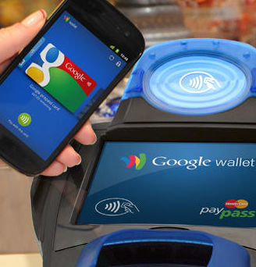
Forces of Change

Slide 3
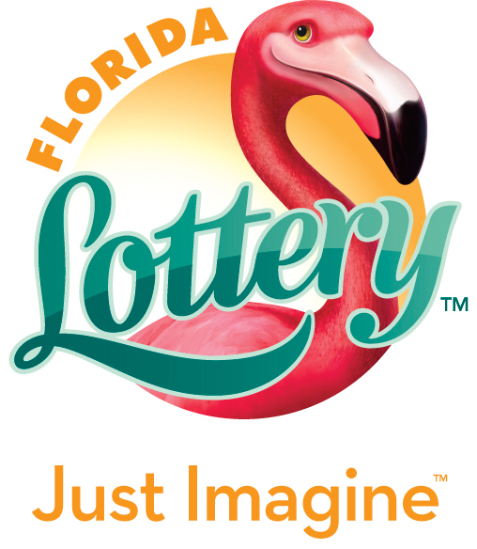
The Reimagined Florida Lottery

Slide 4
Defining the Florida Lottery brand.
Internal
Comm.
New Website Launch
Stakeholder
Comm.
New Ads
25th Anniversary/Rebrand
External
Comm.
Games
Brand Teaser Campaign
New Logo
Hard Launch Event

Slide 5
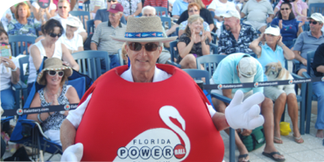
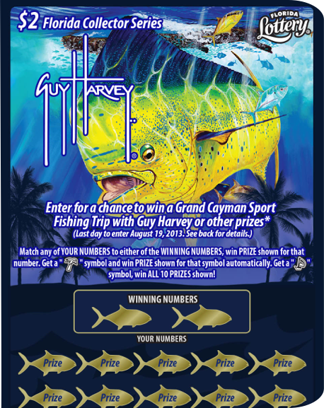
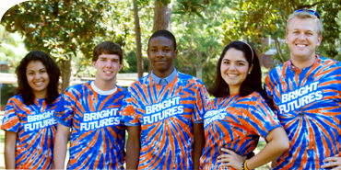
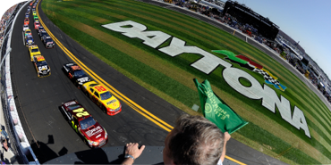
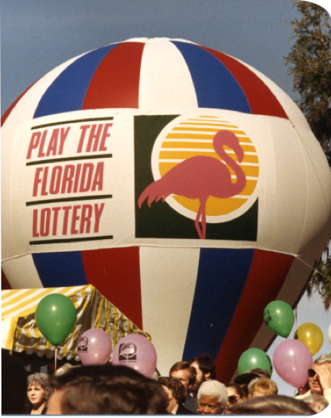
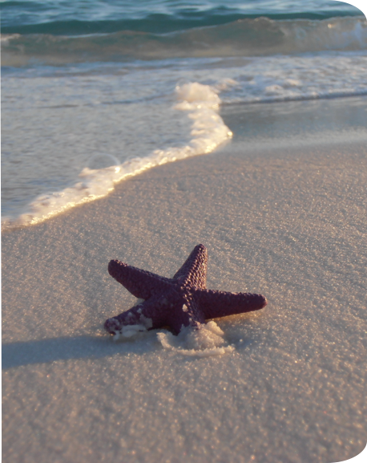
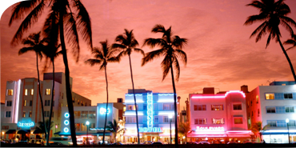
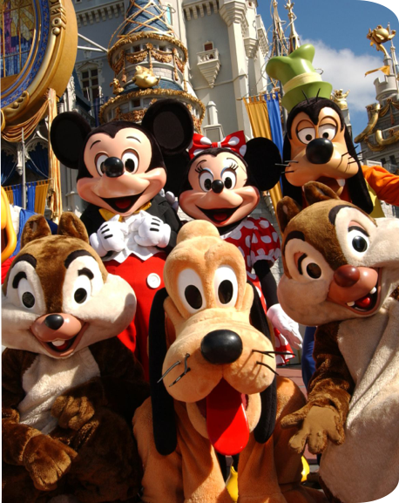
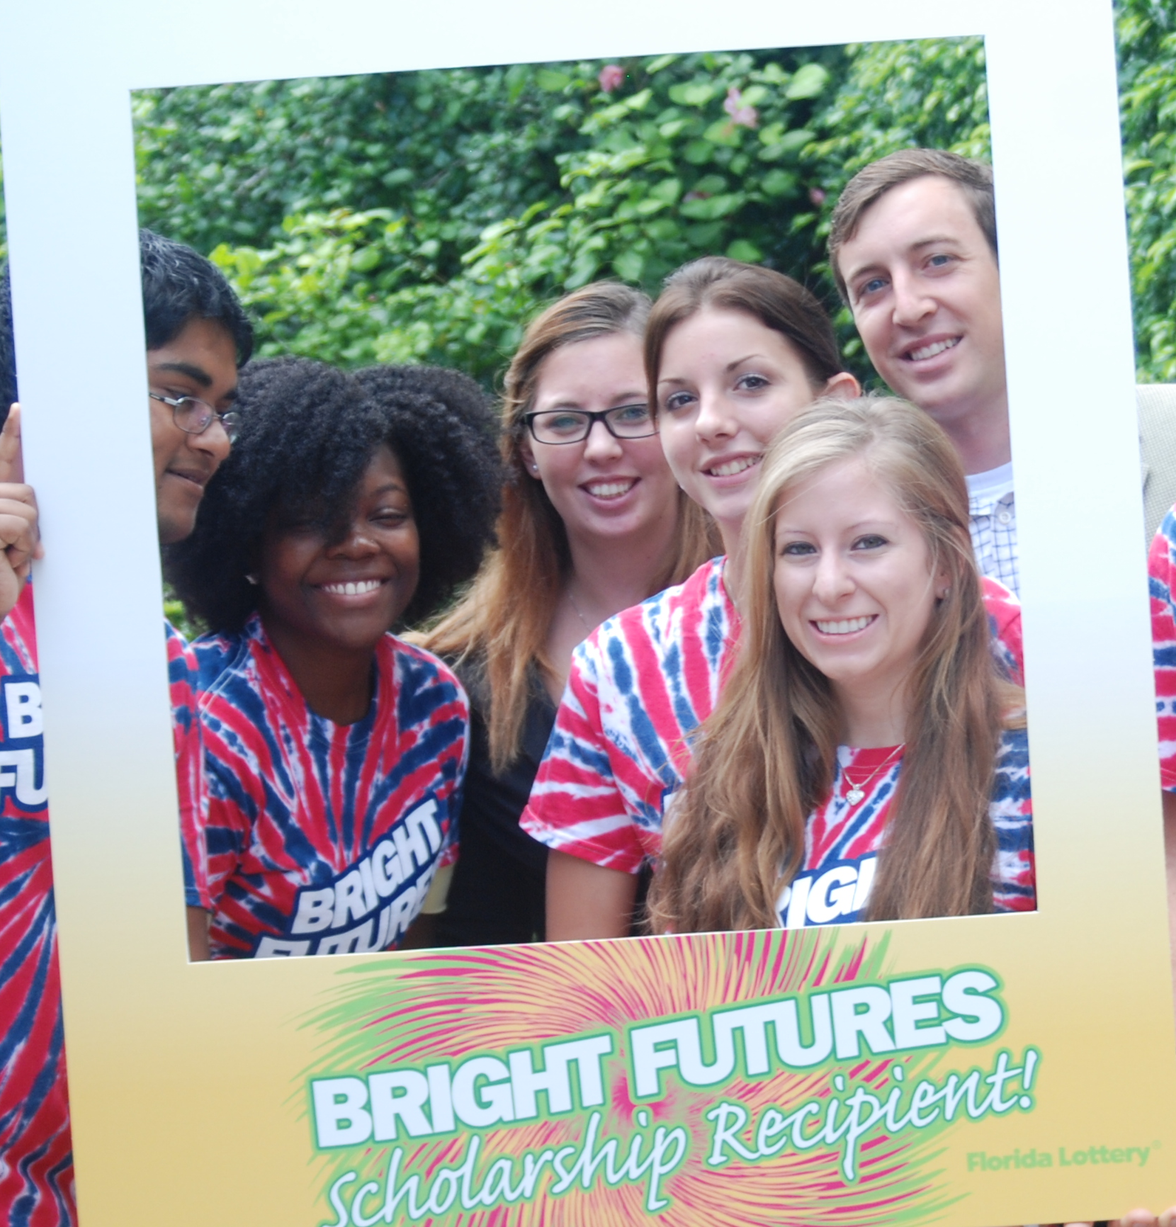
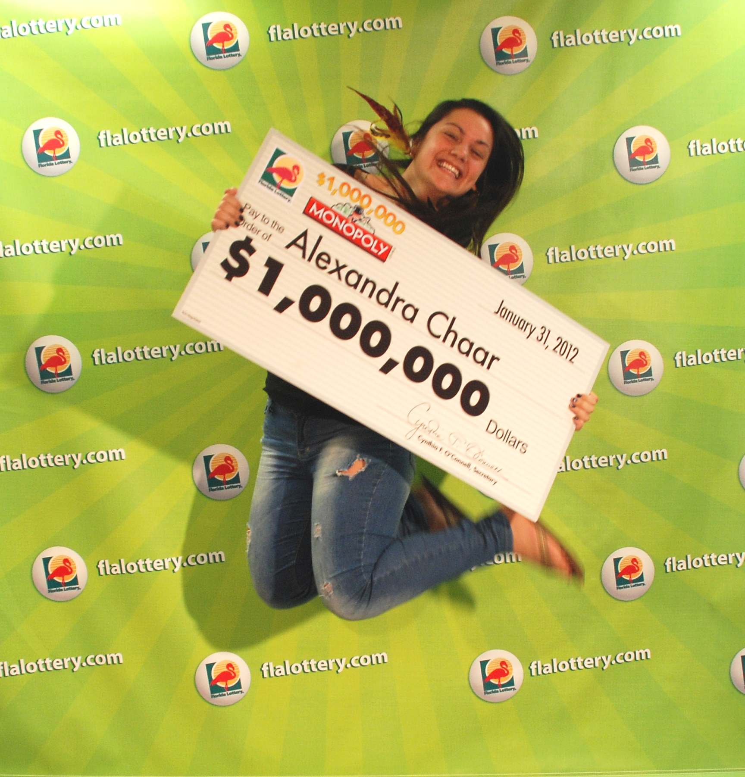
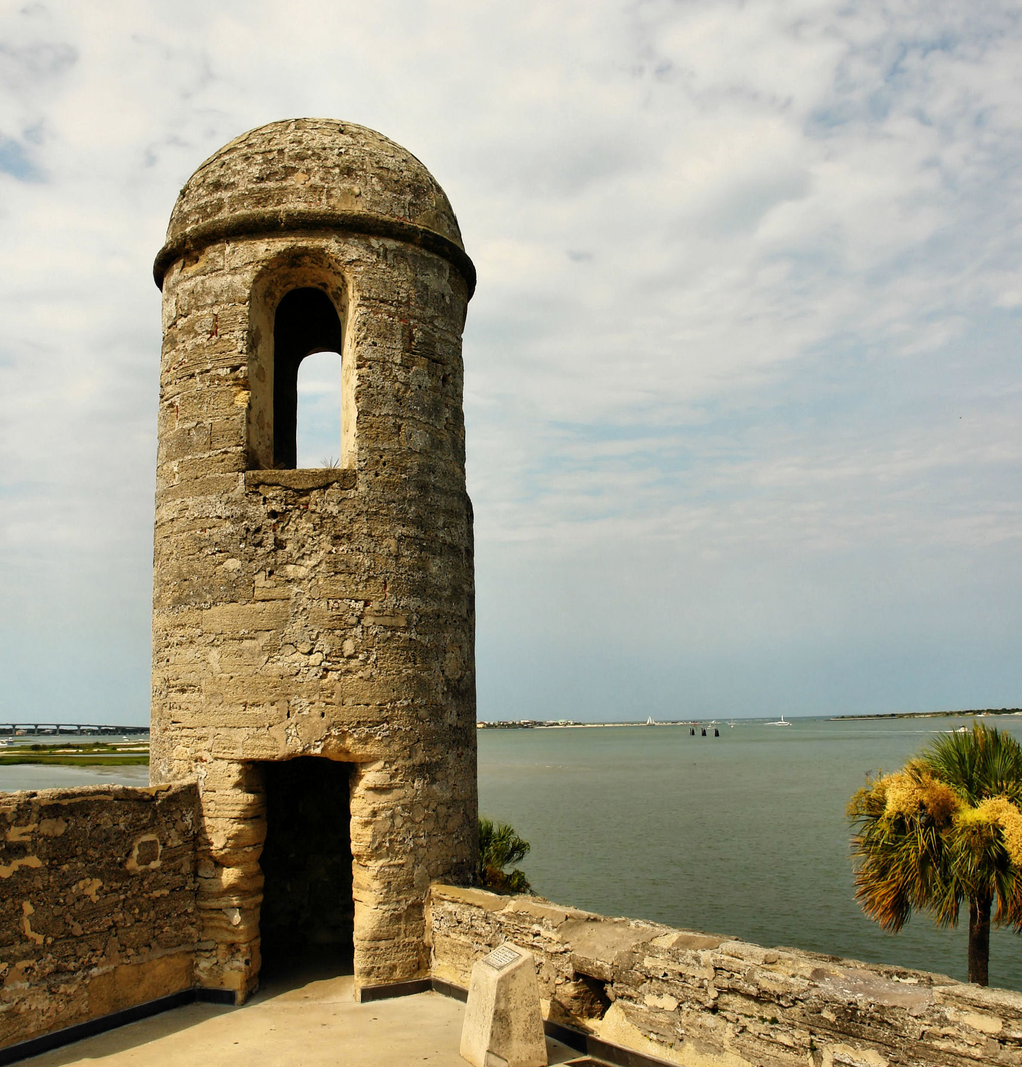

Everything we do is inspired by Floridians.
Florida is a state unlike any other.
Engaging a community in fun takes hard work.

Slide 6





Florida Lottery Brand Pillars

Slide 7
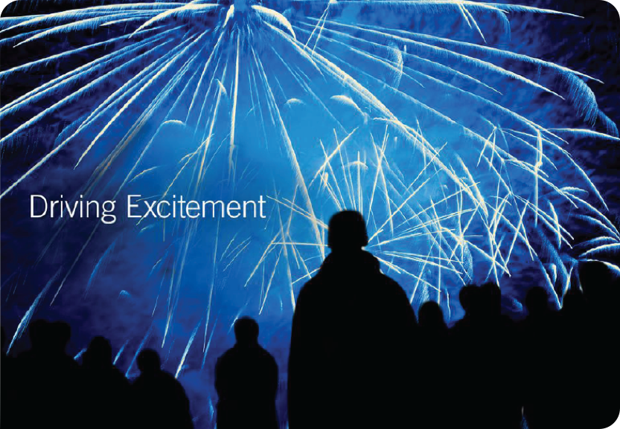
Leaning Florida forward and defining the true meaning of fun.

Slide 8

Investing in a more inspiring future for all.

Slide 9

Remaining accountable to the highest ethical standards.

Slide 10
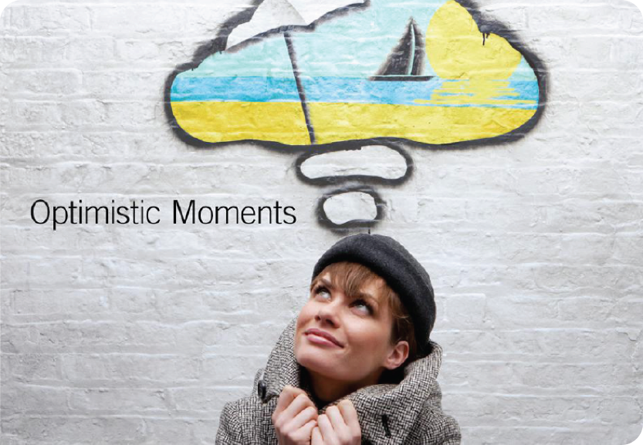
The belief that any day could be the start of something big.

Slide 11
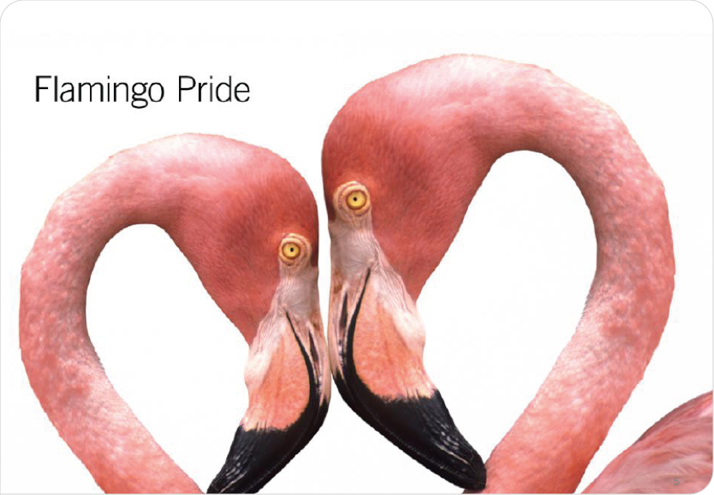
Inspiring imagination in all who live and play in Florida.

Slide 12
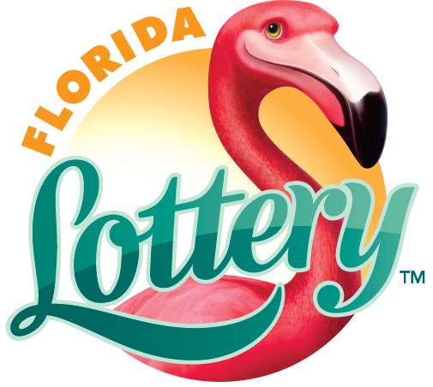

The Reimagined Florida Lottery

Slide 13
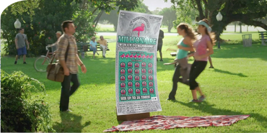
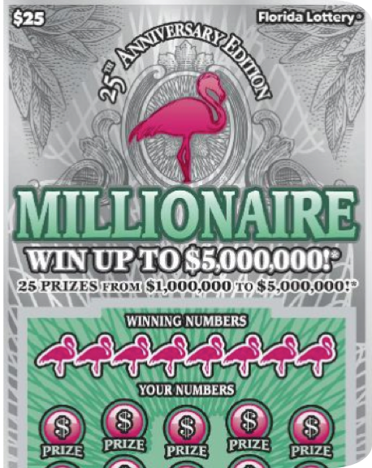

25th Anniversary Edition
of the game that started it all.

Slide 14


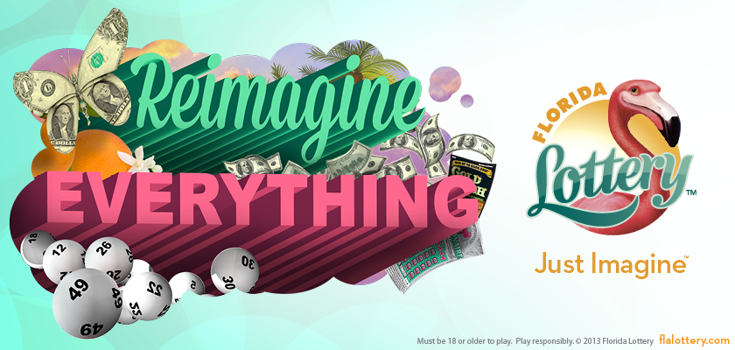
Reimagine Campaign

Slide 15

Operational efficiencies minimized costs.

Slide 16
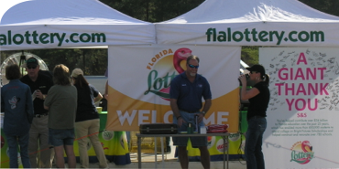
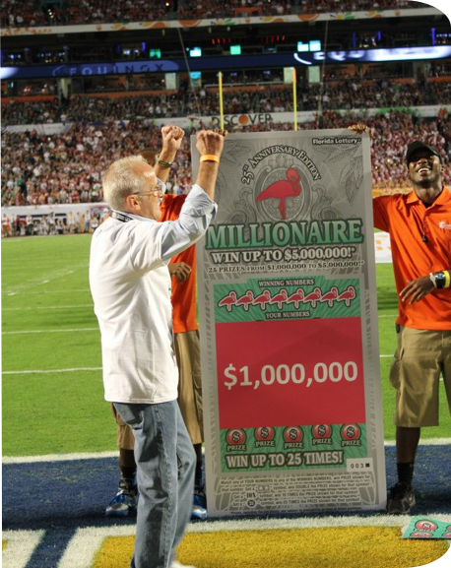
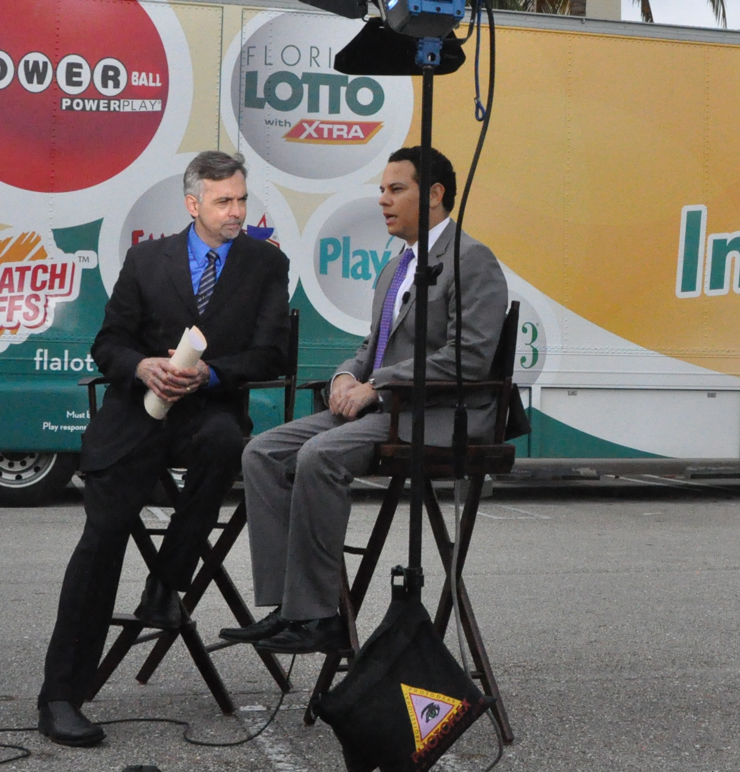
Introducing the
Reimagined Florida Lottery to Floridians.

Slide 17
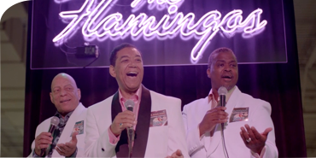
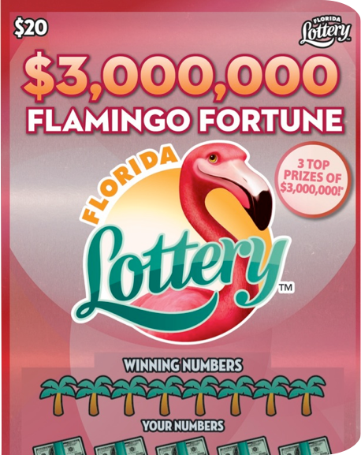
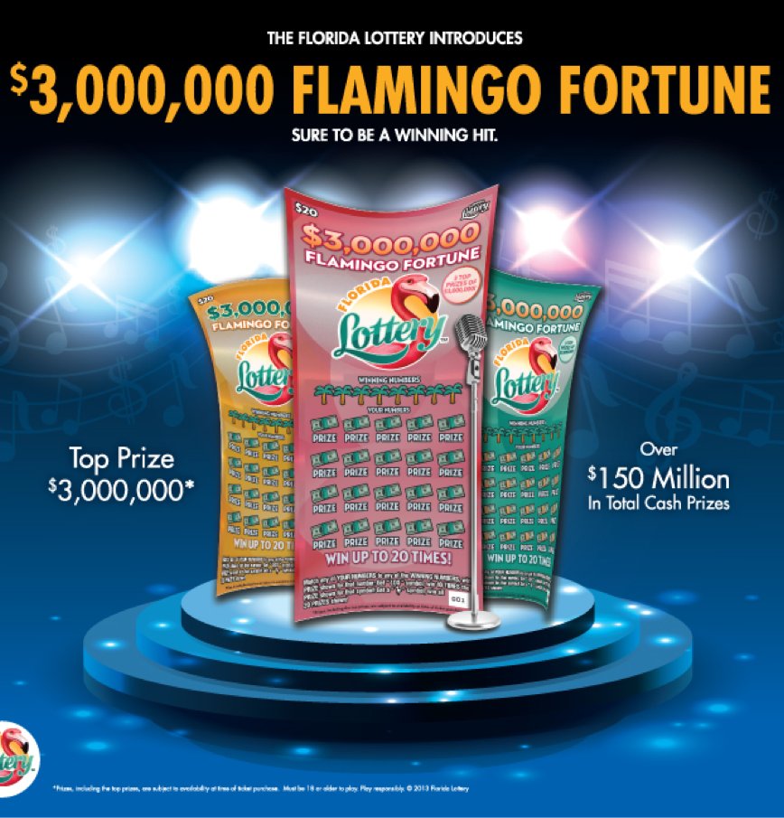
Flamingo Fortune Scratch-Off

Slide 18

Celebrating $25 billion contributed to education.

Slide 19
The Reimagined Florida Lottery

